Slide 1
IT2771– Rich Internet Applications
Development
Cascading Style Sheets II

Slide 2
Recap
Basic selection techniques
  Type Selectors
  Grouping Selectors
  Combing Declarations
  Descendant Selectors
  Universal Selectors
h1 { color: red; }
h1, h2 { color: red; }
p {
color: blue;
font-size: 125%;
}
p em { color: blue; }
div * { font-family: tahoma; }

Slide 3

Learning Objectives
Learn how to use class and id selectors
Learn how to use the <div> and <span> elements
Learn how to use other selectors

Slide 4
Using Class Selector
Class selector lets you write rules, give them a name, and then apply that name to any elements you choose
Period (.) flag character indicates that the selector is a class selector
Apply the class name using the class attribute to any HTML element
Class Selector
Declaration
Declaration
.special
{ color: blue; font-size: 30px;}
Flag character
Class name
Property
Value
Property
Value
<h1 class=“special”>This heading will be blue with a font size of 30 pixels.</h1>

Slide 5
Using Class Selector
Select elements with greater precision
Class selector can be any name you choose
For example, the following style rule sets all <p> elements in the document to a font size of 12px:
Suppose you want one <p> element in your document to be of different style, you can use a class selector to do it. For example, the following style rule set the style for the class named intro
p { font-size: 12px; }
.intro { font-size: 20px; font-weight: bold; }
<p class=“intro”>This paragraph has a different style based on the “intro” class selector.</p>

Slide 6
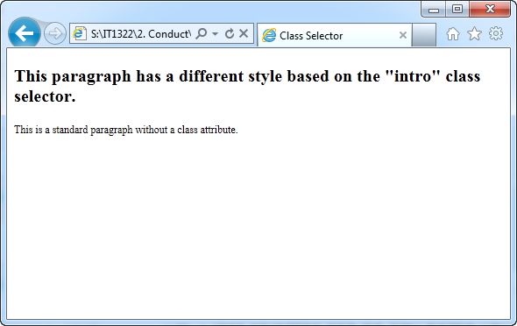
Using Class Selector
<!DOCTYPE html>
<html>
<head>
<title>Class Selector</title>
<style type="text/css">
p { font-size: 12px; }
.intro { font-size: 20px; font-weight: bold; }
</style>
</head>
<body>
<p class="intro">This paragraph has a different style based on the "intro" class selector.</p>
<p>This is a standard paragraph without a class attribute.</p>
</body>
</html>
Notes:
Demo: css_selector.html

Slide 7
More Specific Class Selector
Powerful selection technique that allow you to write style rules that are meaningful to your company or information type
Class selector can be applied to any element, in the above example the intro style can be applied to any element in the document
Restrict use of class attribute to a single element type by adding an element selector before the flag character
  the above style rule restrict the use of the intro style to <p> elements only, if this style is applied to other elements it will not work
<h1 class=“intro”>This heading is based on the “intro” class selector.</h1>
p.intro { font-size: 20px; font-weight: bold; }

Slide 8

Using id Selector
id selector lets you to write rules, give them a name, and then apply that name to any elements you choose
Hash (#) flag character indicates that the selector is a id selector
Apply the id name using the id attribute to any HTML element
Id Selector
Declaration
Declaration
#copyright
{ color: #eeeeee; font-size: 5px;}
Flag character
id name
Property
Value
Property
Value
<p id=“copyright”>This is the copyright information for the page.</p>
Difference between id and class is that id should refer to only one occurrence within a document

Slide 9
More Specific id Selector
Like class selector, id selector can be applied to any element, in the above example the above style can be applied to any element in the document
Restrict use of id attribute to a single element type by adding an element selector before the flag character
  The above style rule restrict the use of the copyright style to <p> elements only, if this style is applied to other elements it will not work
<h1 id=“copyright”>This is the copyright information for the page.</h1>
p#copyright { color: #eeeeee; font-size: 5px; }

Slide 10

Using <div> and <span> Elements
<div> (division) and <span> (span of words) elements are designed to be used with CSS
Specify logical divisions within a document
Differences between <div> and <span>
<div>
Takes as much width of the page as possible, anything after <div> tag go to the next line beneath it
<span>
Inline element
Takes as little space as possible, only enough to contain its contents
Block element

Slide 11
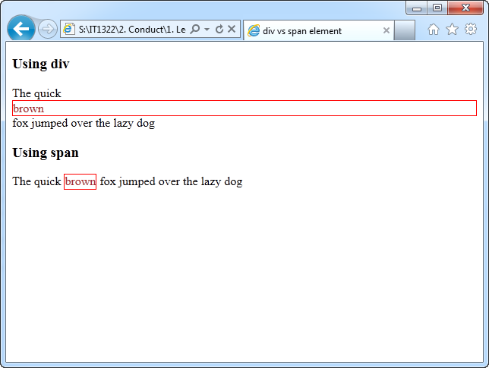
<div> vs <span> Elements
Takes the width of the page, block out the whole section of the page
<!DOCTYPE html>
<html>
<head>
<title>div vs span element</title>
<style type="text/css">
span, div {
border: 1px solid red;
color: brown;
}
</style>
</head>
<body>
<h3>Using div</h3>
The quick <div>brown</div> fox jumped over the lazy dog
<h3>Using span</h3>
The quick <span>brown</span> fox jumped over the lazy dog
</body>
</html>
Takes as little space as possible, only enough to contain its content
Notes:
Demo: divSpan.html

Slide 12
<div> Elements
Use <div> element with the class and id attributes to create logical divisions on a Web page (header, footer, column, etc)
<div> element can contain other block level elements such as paragraphs or even other divisions
Divisions are main content container replacing use of tables
<div>

Slide 13
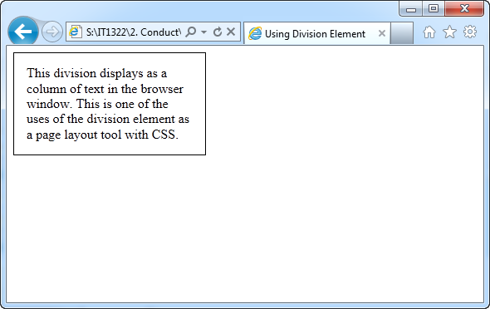
<div> Elements
<!DOCTYPE html>
<html>
<head>
<title>Class Selector</title>
<style type="text/css">
div#column {
width: 200px;
height: auto;
padding: 15px;
border: thin solid;
}
</style>
</head>
<body>
<div id="column">This division displays as a column of text in the browser window. This is one of the uses of the division element as a page layout tool with CSS.</div>
</body>
</html>
Notes:
Demo: division.html

Slide 14
<span> Elements
<span> element lets you specify inline elements within a document that have their own name and style properties
Inline element reside within a line of text, like <strong> or <em> element
Use <span> with class or id attribute to create customized inline elements
<span>

Slide 15
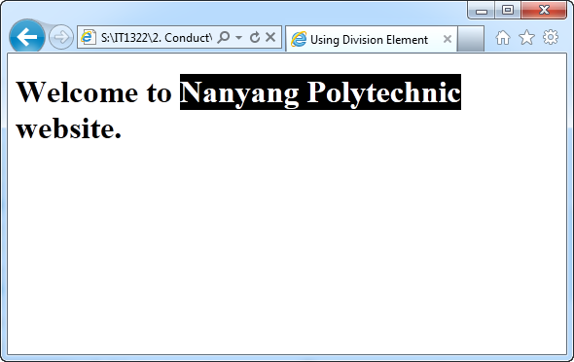
<span> Elements
<!DOCTYPE html>
<html>
<head>
<title>Class Selector</title>
<style type="text/css">
span.logo {
color: white;
background-color: black;
}
</style>
</head>
<body>
<h1>Welcome to <span class="logo">Nanyang Polytechnic</span> website.</h1>
</body>
</html>
Notes:
Demo: span.html

Slide 16
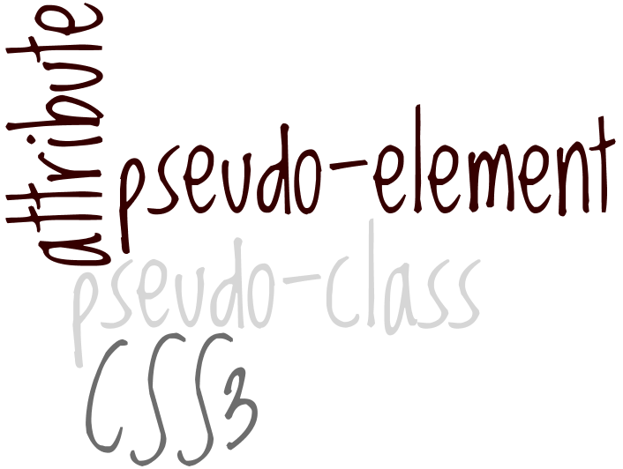
Other Selectors
Beside class and id selectors, you can use:
  Attribute selector
  pseudo-class selector
  pseudo-element selector
  CSS3 selector
For this module we will focus on pseudo-class selector

Slide 17
Attribute and Pseudo-elements Selector
Attribute Selector
  Let you select an element based on whether the element contains an attribute
  Can also choose element based on specific value for the attribute
CSS3 Selector
  Let you select element with even greater precision, such as first or last paragraph on every page, or setting different styles for odd and even rows of a table or list
Pseudo-elements Selector
  Allow you to change other aspects of a document that are not classified by elements, such as applying style rules to first letter or first line of a paragraph

Slide 18
Using Pseudo-classes Selector
Pseudo-classes Selector
  Select elements based on characteristics other than their element name, such as change color of a new or visited hypertext link
Pseudo-class | Description
:link | Selects any unvisited link that user has not clicked or is not hovering over with their mouse pointer
:visited | Selects any link that user has already visited
:hover | Selects any link that user is pointing to with the mouse pointer
:active | Selects a link for the brief moment that user is actually clicking the link

Slide 19
Using Pseudo-classes Selector
Pseudo-classes Selector
  The following style rules change the color of the hypertext links in a Web page:
  Note that the colon(:) is the flag character for a pseudo-class
  :hover pseudo-class lets you apply a style that appears when user points to an element with a mouse
a:link { color: red; }
a:visited { color: green; }
a:hover { background-color: yellow; }
You should always place your link pseudo-class in the following order:
  Link
  Visited
  Hover
  Active

Slide 20
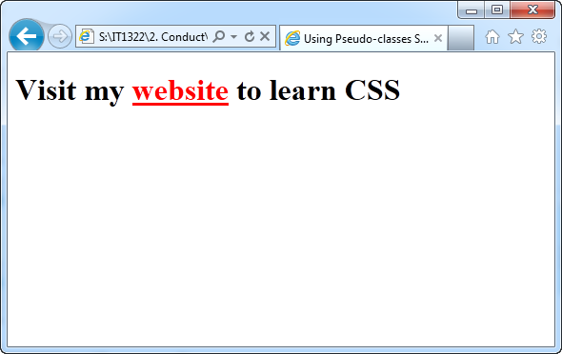
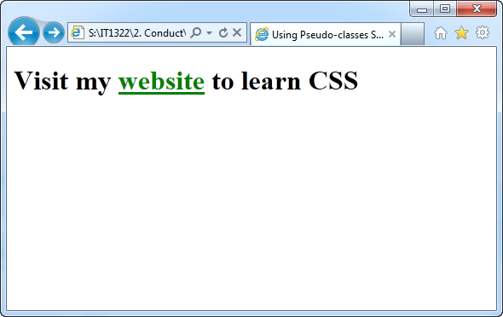
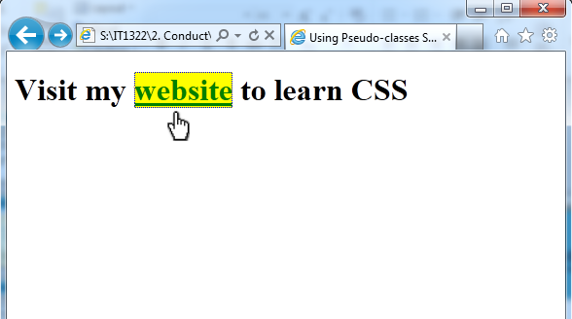
Using Pseudo-classes Selector
<!DOCTYPE html>
<html>
<head>
<title>Class Selector</title>
<style type="text/css">
a:link { color: red; }
a:visited { color: green; }
a:hover { background-color: yellow; }
</style>
</head>
<body>
<h1>Visit my <a href="page.html">website</a> to learn CSS</h1>
</body>
</html>
:hover pseudo-class is activated by the mouse pointer
Notes:
Demo: pseudo-class.html

Slide 21
Cascade affects Style Rules
CSS cascading mechanism determines which rules are applied to document elements by assigning weight to each rule based on the following:
  Specificity of the selector
  Order of the rule in the style sheet
  Use of the !important keyword

Slide 22
Determine Rule Weight by Specificity
Rules with more specific selectors take precedence over rules with less specific selectors
Inline styles, using the style attribute, have the greatest weight
Styles with id selectors override styles with class selectors
Class selectors override simple type selector
More specific descendant selector determine the outcome so the <p> element contained within a <div> will be blue
p { color: red; }
div p { color: blue; }

Slide 23
Determine Rule Weight by Order
Apply rule based on its order within a style sheet
Rules that are included later in the style sheet order take precedence over earlier rules
In this example, <h1> element in the document appear green because the last style rule specifies green as the color
body { color: black; }
h1 { color: red; }
h1 { color: green; }

Slide 24
Summary
Use class and id attribute selectors paired with the <div> and <span> HTML elements
With class and id selector, you can create rules, name them, and apply them to any HTML element
Pseudo-class selector let you change the color and styling of hypertext links that are not signified with the standard HTML elements

